Slide 1
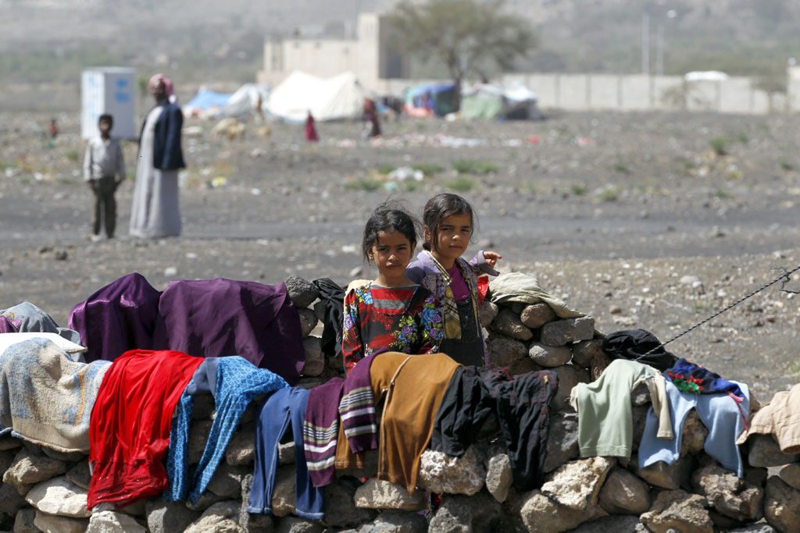
REFUGEE CRISIS
BY TAMARA TRENCSÉNYI AND LILLA SZAPPANOS

Slide 2
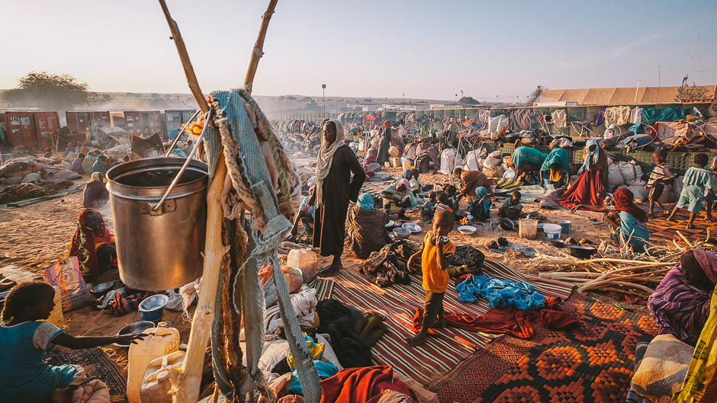
Who is a refugee?
A refugee is a person who has fled their own country because they are at risk of serious human rights violations there. Because their own government cannot or will not protect them, they are forced to seek international protection.
There are currently over 65
million refugees in the world.

Slide 3
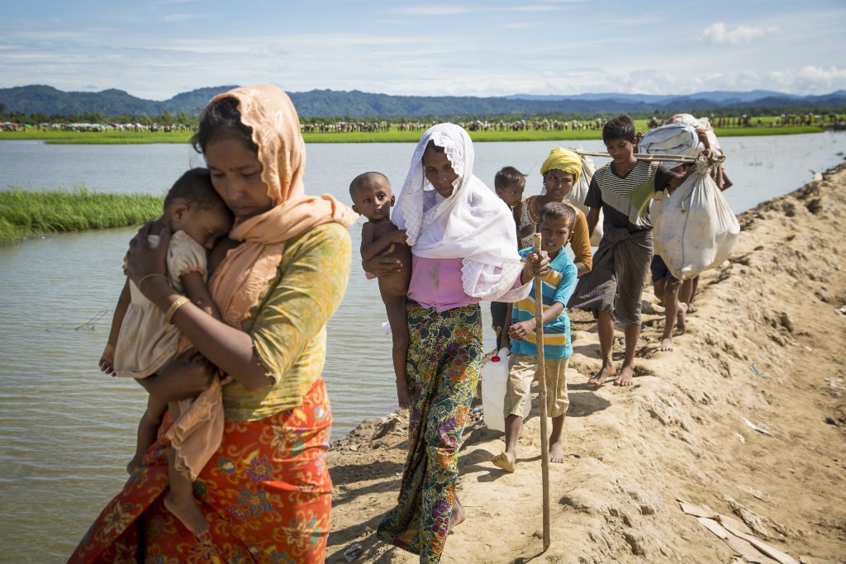
WHY TODAY’S REFUGEES HAVE TO FLEE?
They’re forced to flee persecution for their political or religious beliefs, ethnicity, nationality of a particular social group
They’re compelled to leave as a result of war
They’re displaced because of “natural” disasters, occurring increasingly as a consequence of climate change.

Slide 4
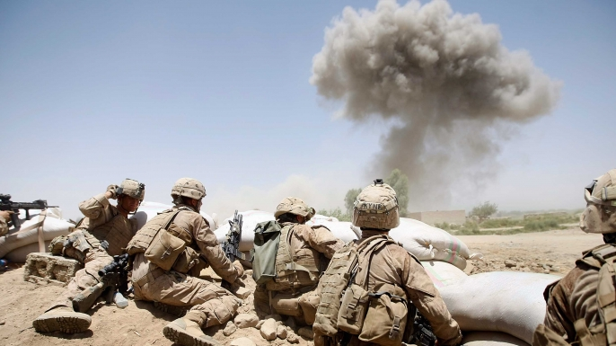
War and persecution
Middle east is the most affected area on the globe.
55% of the world’s refugees come from three countries: South Sudan, Afghanistan and Syria.

Slide 5
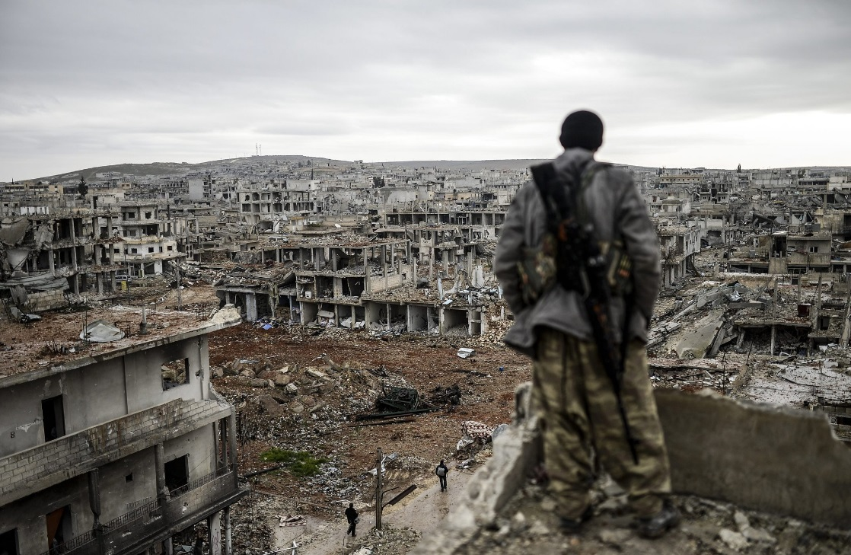
Syria
Iraq
Enormous suffering
11 million people were displaced, about half of them within the country
Refugees of Iraq are displaced due to the Iraq War and persecution
They have fled to nearby states including Pakistan, Jordan, Syria, Lebanon, Egypt, Turkey, and Iran.

Slide 6
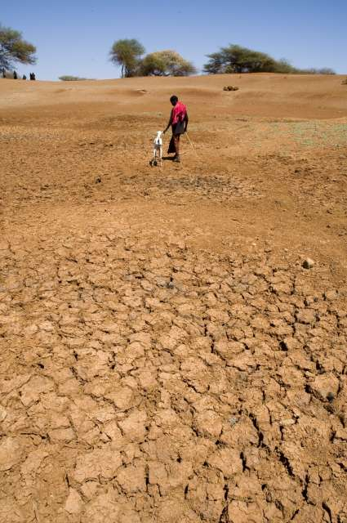
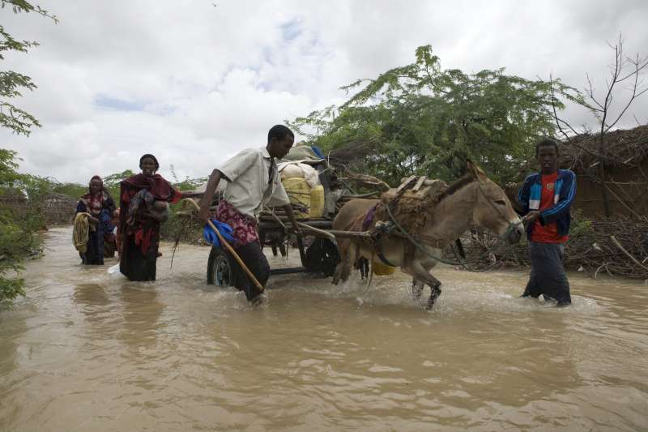
The Earth’s climate is changing, therefore families and communities have already started to suffer from disasters and the consequences of climate change, forced to leave their homes.
Drought and desertification already ruined a lot of productive land in China and in some African countries.

Slide 7
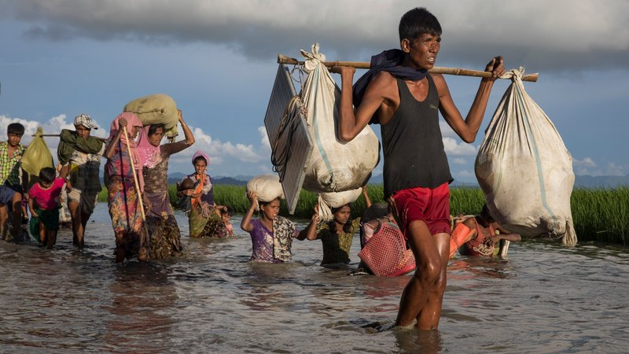
In addition to persecution and conflict, causes of people seeking refuge can be:
natural disaster (due to climate change) :floods, earthquakes, hurricanes, mudslides
Drought
desertification
the salinization of ground water and soil,
and rising sea levels
climate change
severe socio-economic deprivation
lack of: food
Water
Education
health care and a livelihood

Slide 8
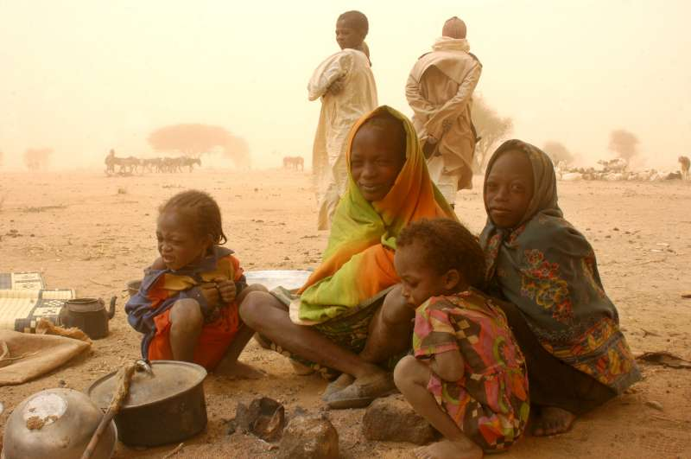
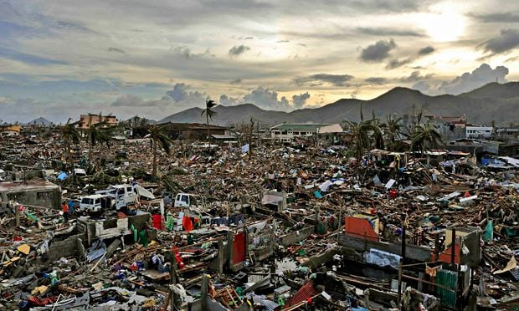
Natural disasters displaced more people than war in 2013.
Mega-disasters attract international attention, but smaller-scale damages often go unrecorded.
Somalia, South Sudan, Lake Chad Basin

